Slide 1

Major Project-II (CA401P) Even Semester Session 2025-2026
Get Prep
Tarun Kumar – 202410116100223
Tushar Kumar – 202410116100227
Vaibhav Singh Kalura – 202410116100233
Vishal Dagar - 202410116100249
Project Supervisor:
Dr. Amit Kumar Gupta
Ms. Anita Yadav
Dr. Neelam Rawat
Project Incharge :
Dr. Ankit Verma
Ms. Annu Yadav

Slide 2

The Problem We're Solving
The Gap in Preparation
Key Challenges
Most candidates enter technical interviews unprepared — lacking personalized feedback, real-time practice environments, and structured guidance tailored to their skill level and target role.
No adaptive feedback — generic mock tests don't reflect real interviews
Unstructured practice — candidates don't know what to focus on
No performance tracking — progress is invisible and unmeasurable
Lack of AI assistance — no intelligent guidance during preparation

Slide 3
Objectives of the Project
AI-Driven Mock Interviews
Performance Analytics Dashboard
Simulate real interview scenarios using OpenAI API with adaptive questioning based on user performance.
Provide detailed, real-time feedback and progress tracking across topics, difficulty levels, and domains.
Live Coding Environment
Personalized Learning Paths
Integrate an in-browser code editor supporting multiple languages with AI-assisted hints and evaluation.
Recommend curated preparation roadmaps aligned to specific roles such as SDE, Data Scientist, or Full Stack Developer.

Slide 4
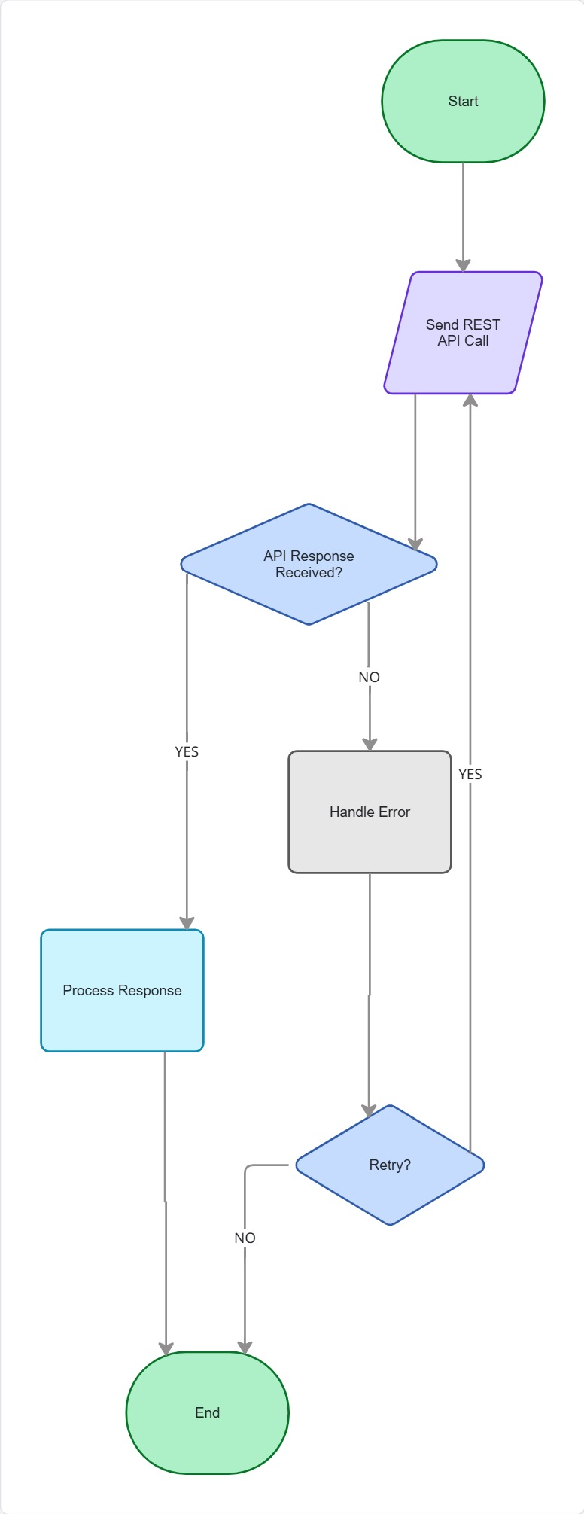
System Architecture
Architectural Highlights
React.js frontend delivers a responsive, dashboard-style UI
Node.js / Express RESTful backend handles session and logic
OpenAI API powers adaptive questioning and answer evaluation
MongoDB stores user sessions, responses, and progress logs
MySQL manages structured data: users, roles, question banks

Slide 5
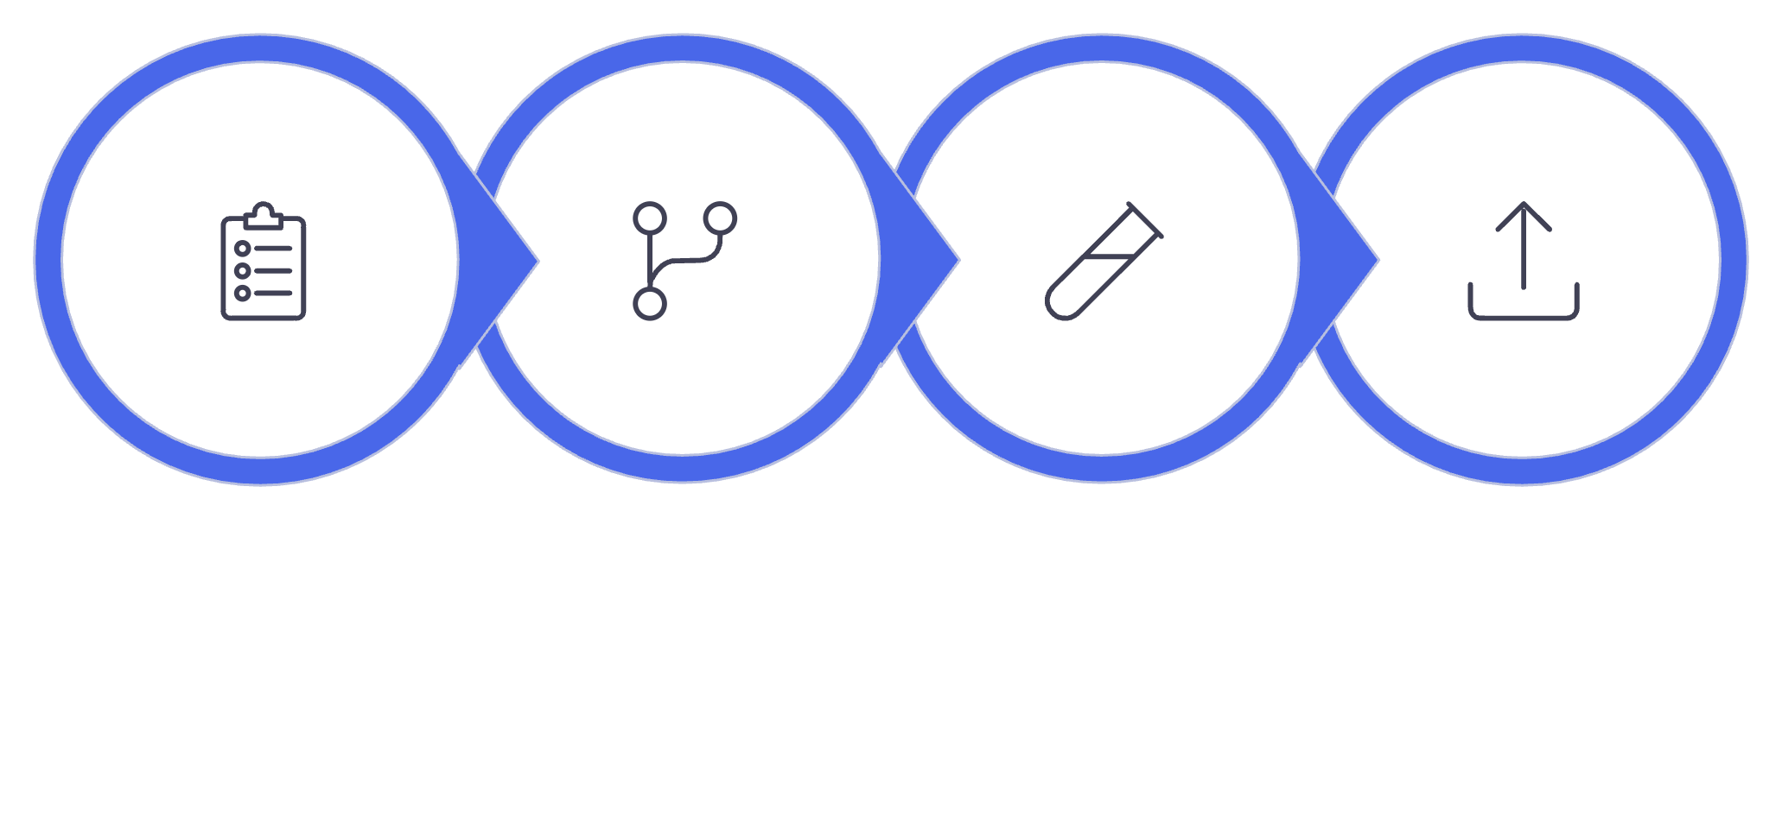
Technology Stack & Methodology
⚛️ Frontend
React.js, Tailwind CSS, Axios
Development Methodology
The project followed an Agile SDLC approach with two-week sprints, continuous integration, and iterative feedback cycles.
🐍 Backend
Node.js, Express.js
🗄️ Database
MongoDB, MySQL
🤖 AI Layer
OpenAI GPT API, NLP
Plan
Build
Test
Deploy
🛠️ Dev Tools
GitHub, VS Code, Postman

Slide 6
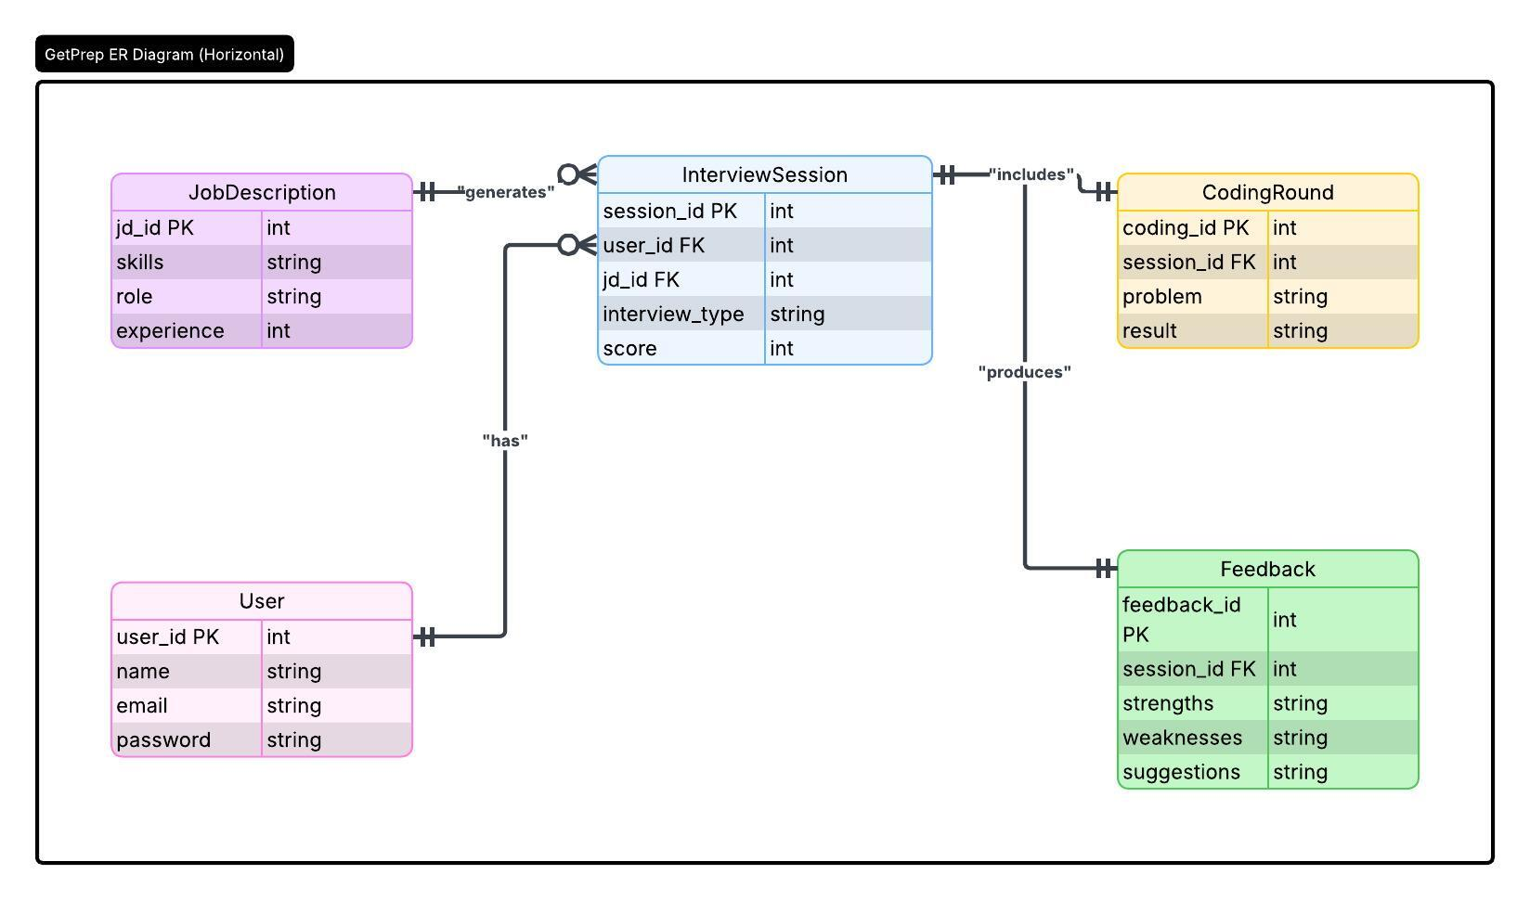
Entity Relationship Diagram

Slide 7
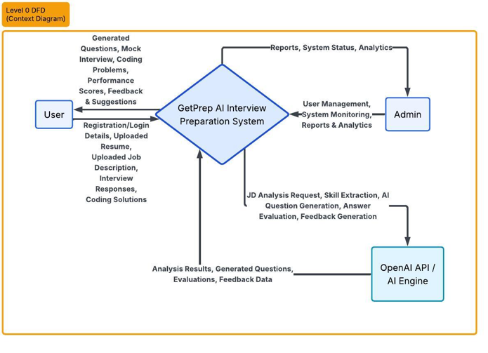
Data Flow Diagram (DFD) - Level 0

Slide 8
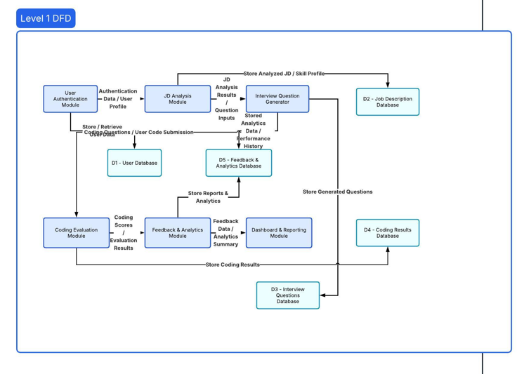
Data Flow Diagram (DFD) - Level 1

Slide 9
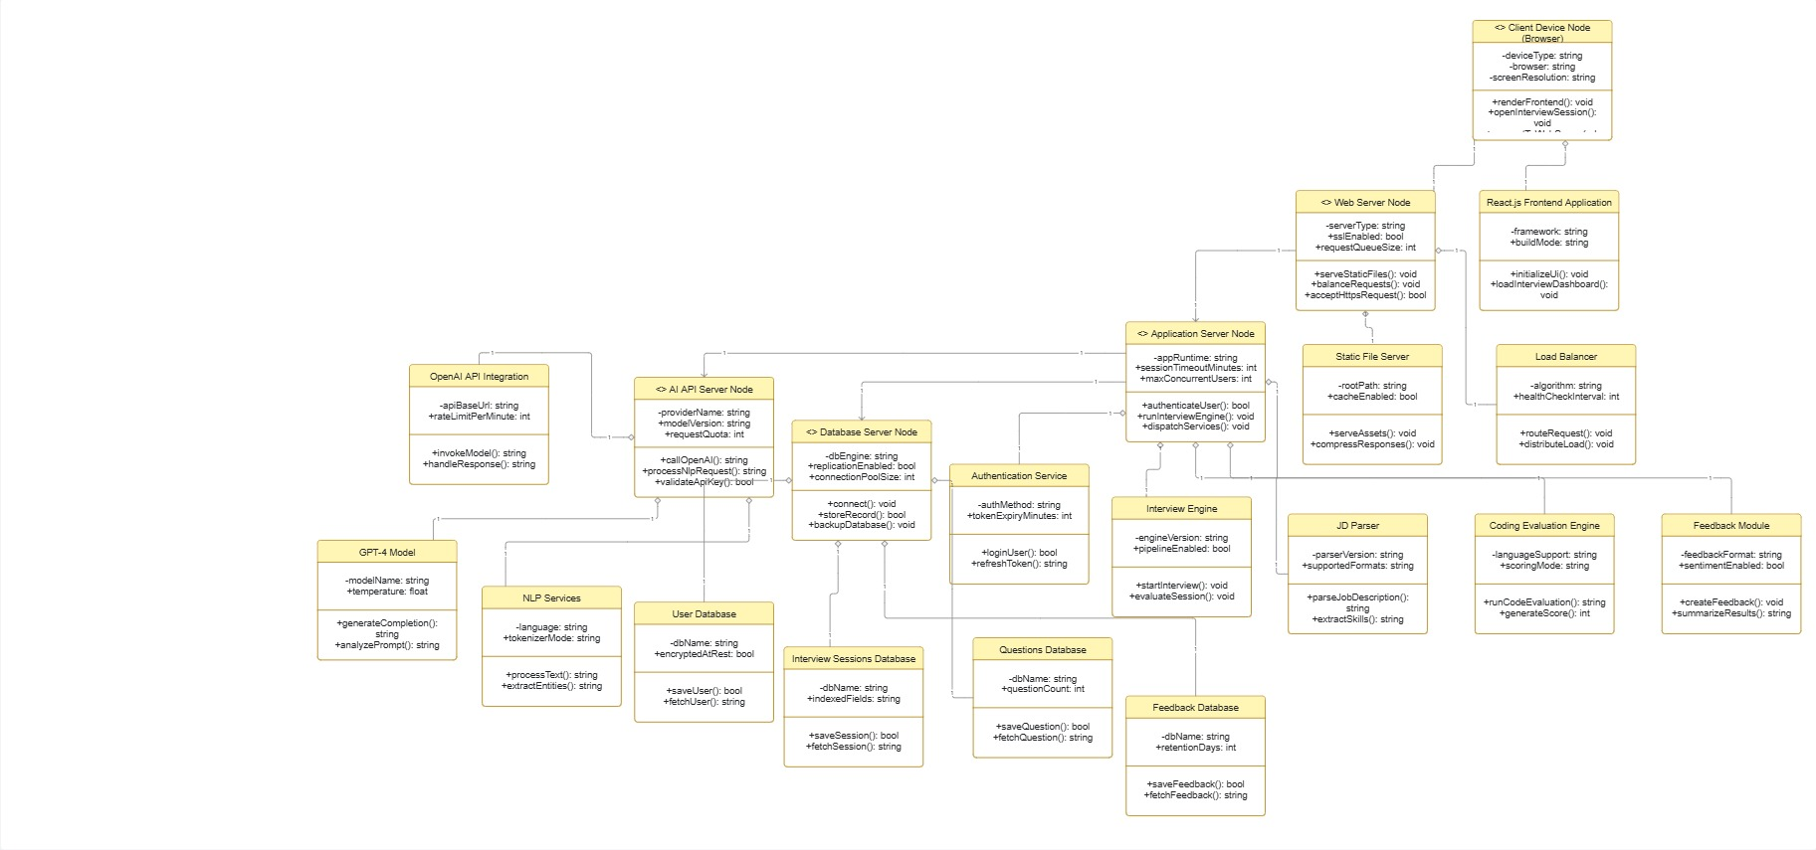
UML Use Case Diagram: User Interactions

Slide 10

GitHub Repository & Testing Results
Repository Overview
Testing Summary
Version-controlled with GitHub using feature-branch workflow
Structured into frontend/, backend/, ai-engine/, and docs/ directories
CI/CD pipeline configured with GitHub Actions for automated builds
Unit Testing
PyTest — 94% pass rate across all API endpoints
API Testing
Postman collections validated all REST routes
UAT
Beta tested with 20 MCA peers; 88% satisfaction score

Slide 11
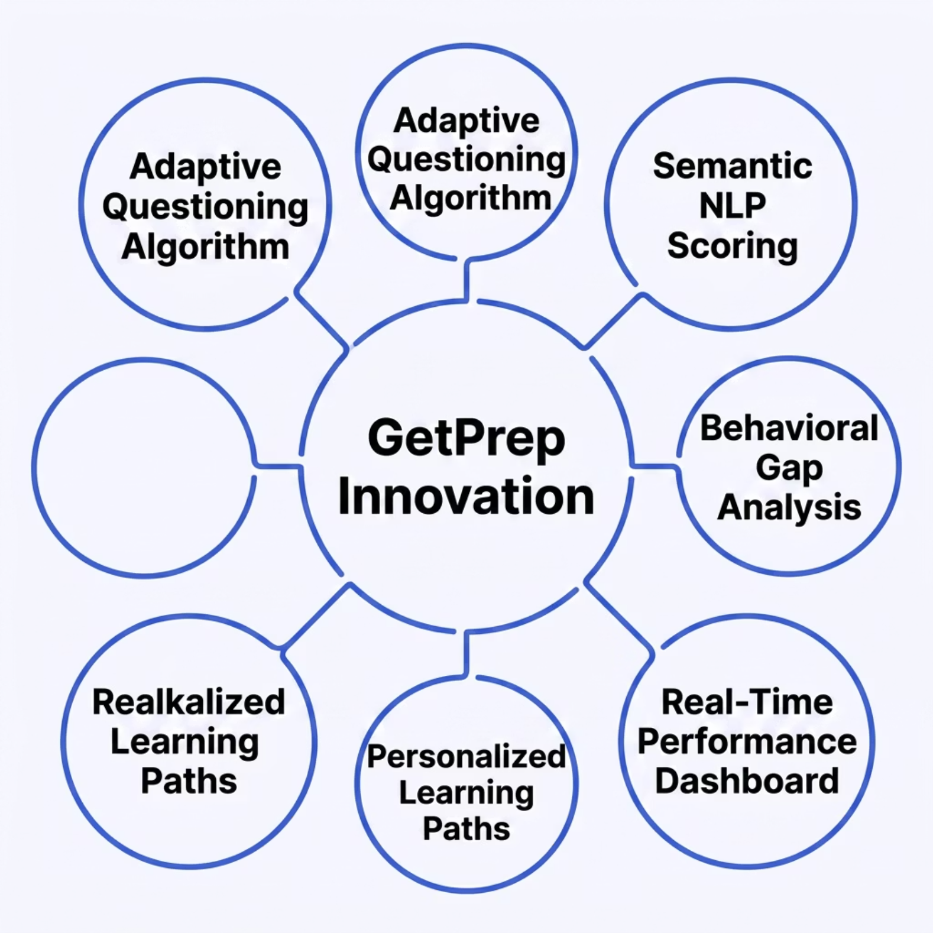


Research Outcomes & Patent Scope
Key Research Contributions
Adaptive AI Questioning: A novel algorithm dynamically adjusts question difficulty based on live response quality using GPT embeddings
Semantic Answer Evaluation: NLP-based scoring model benchmarks free-text answers against expert responses
Behavioral Pattern Analysis: Tracks hesitation time and keyword patterns to identify knowledge gaps
Eligible for filing under Indian Patent Act — Section 6 as a computer-implemented invention with a novel AI-driven evaluation methodology.

Slide 12
Future Enhancements
Phase 1 — Q3 2025
1
Voice-based interview simulation with speech-to-text AI evaluation and tone analysis
2
Phase 2 — Q4 2025
Resume parser integration — auto-generates personalized question sets from uploaded resumes
Phase 3 — Q1 2026
3
Company-specific interview tracks for top tech firms (Google, Amazon, Microsoft) with historical question datasets
4
Phase 4 — Q2 2026
Mobile application launch (iOS & Android) with offline practice mode and push-notification reminders

Slide 13

Conclusion
GetPrep bridges the critical gap between academic learning and real-world interview readiness through intelligent, adaptive AI technology.
🎯 Problem Solved
⚙️ Technically Sound
Personalized, AI-driven mock interviews replacing static, generic practice tools
Built on a robust, scalable stack — React, Flask, OpenAI API, and dual-database architecture
🚀 Future-Ready
Clear roadmap for voice AI, mobile expansion, and company-specific tracks makes GetPrep commercially viable
GetPrep is not just a project — it is a deployable, research-backed platform designed to redefine how candidates prepare for technical careers.

